Slide 1
CISC108
Introduction to Computer Science
[Professor Name]
University of Delaware
Week 9 - Time Analysis
Notes:
Sorting algorithm visualizations.
Make them experience stepping through a linear vs logarithmic vs quadratic algorithm.

Slide 2
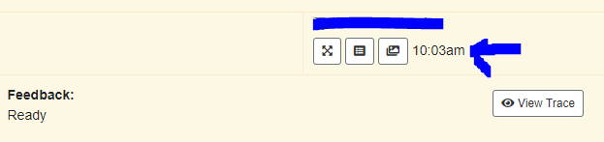
Reminders
Midterm 2 next week!
Register for the exam!
Fill out Exam Trouble if there’s any issues pre- or post- exam
New exam feature: clock in top-right corner will tell you the current time
DSS Accommodations? Fill out the form ASAP.

Slide 3
The Three Criteria for Programs
Correctness
Readability
Efficiency
Does it work?
Can humans understand it?
What does it cost to run?
Notes:
Review the three criteria that we use to evaluate software.
I like to mention the following:
Correctness is not always completely necessary, in advanced classes we’ll learn about “approximation algorithms” that find a “good enough” answer. But usually we need the answer to be completely correct or it’s not worth anything.
Readability really matters because most code is “written for humans and only incidentally meant to be executed” (Harold Abelson, SICP). We spend a lot more time debugging and reading code than we do writing it, so you need to make sure that it’s easy to read. Mention how last week it was so hard to read and debug the big blob of messy code. It really matters!
Efficiency is the last criteria, and is what we are talking about today. Mention that efficiency is actually a broader conversation about what resources are needed to run the code, but we’ll be focusing mostly just on time so far.

Slide 4




“Cost”? “Efficiency”?
Time
Memory/Space
Energy
Bandwidth
How many seconds, minutes, etc.
How much data is actually being used?
How much energy is the device using?
How long does it take to transfer the data over a network?

Slide 5
Two serious ways to measure “fast”
Time
Steps
As measured by a clock
As measured by tracing through the program (e.g., with a debugger)
Notes:
The textbook also talks about how you can technically measure program’s length in lines of code, but that’s silly and not serious. Properly speaking, we only have two ways to really measure how long programs are: the wall clock time (e.g., a stopwatch) and the steps. We’ll go into more detail shortly so don’t spend too much time here.

Slide 6
Time is Limited
Run | Duration
Run #1 | 1min 15sec
Run #2 | 1min 10sec
Run #3 | 2min 30sec
Run #4 | 1min 12sec
… | …
Best Time | 1min 10sec
Measuring time takes time!
Need many runs to calculate an accurate average time.
Plus only gives numbers for one specific machine.
Notes:
Time is a poor metric because even though it’s very specific, it takes a long time to do, especially if you want to get an accurate estimate by running multiple times. Also, the data can be too specific - you’re really only learning how your algorithm runs on ONE machine. So as hardware changes over time, you could get very different numbers.
If you have time, you can mention that the conventional wisdom when evaluating the “average” time that a program takes is actually to use the *minimum* time recorded for multiple runs, rather than the mean or median (so that you are ignoring outliers). But this is a fairly advanced topic to bring up.

Slide 7
Tracing Steps with the “RAM” Model
(Random Access Machine)
Notes:
This brings us to one of the big ideas of the chapter, using the Random Access Machine Model to approximate steps. Mention that RAM has nothing to do with Random Access Memory or anything like that. The name isn’t terribly important, and requires some knowledge of assembly to really explain. For now, it’s just a name to them.

Slide 8
Tracing Steps
(approximately)
One Step
N Steps
Variable Steps
Read/write variable
Math/logic operation
Append/index list
Branch on IF/ELSE
Call/return function
Define/make dataclass
Iterate list/string with FOR loop
Body of function
While Loop
Notes:
Go through the basic rules for tracing programs. Most statements only take a single step - highlight that the “call/return function” one only means “starting and ending the function”, because the actual “body of the function” can vary heavily depending on what the body is.
We’ll explain the N Steps in a second, but for now you just want to highlight that FOR loops are special since they take one step per element in the list.
Otherwise, the two really hard ones are WHILE loops and function bodies that can vary quite widely.

Slide 9
Averaging numbers
values = input("Enter values:")
numbers = values.split(",")
total = 0
count = 0
for number in numbers:
total = total + int(number)
count = count + 1
print(total/count)
1 step
1 step
n steps*
1 step
1 step
1 step
Each extra number that the user types requires another loop iteration
2*n + 3 steps
(where n is the quantity of values that the user enters with input)
Notes:
The step counts appear here as an animation.
Gloss over the conversation about how many steps the input function takes; that’s too messy to focus on. Instead, your goal is to talk about how much work the other parts are doing. For now just say that getting input is a single step.
Explain that the N is how many numbers they typed in when input was called.
The split method will take longer the more numbers are in the user-inputted string.
Point out that the for loop does one step per element of the list, so it ends up being another n steps.
Then it’s just a matter of initializing total and printing, which are two additional steps.
So the final total is 2n+3 steps, as an approximation.

Slide 10
Possible inputs and their approximate steps:
(no input)
1
1,2,3,4
(0 numbers)
2*0 + 3
=3
(1 number)
2*1 + 3
=5
(4 numbers)
2*4 + 3
=11
0,0,0,0,0,0,0,0,0,0,0
500,500,500,500
1,2,3,4,5,6,7,8,9,10
(11 numbers)
2*11 + 3
=25
(4 numbers)
2*4 + 3
=11
(10 numbers)
2*10 + 3
=23
Notes:
Let’s look at some possible inputs they could type, and how many steps it would take in practice.

Slide 11
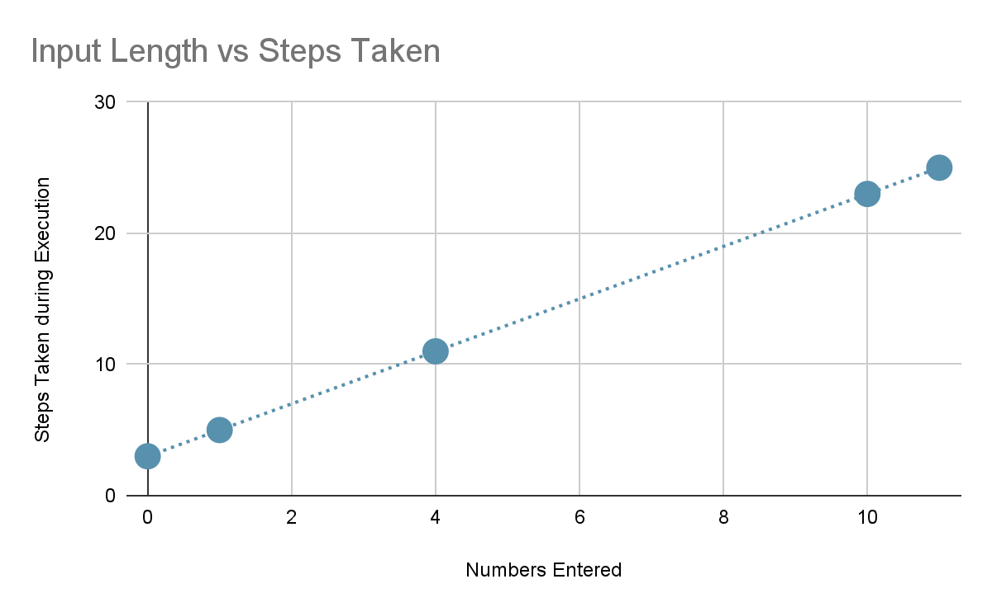
Plotting the data
steps(n) = 2n+3
Notes:
If we plot the points, we get a line showing a *linear* relationship. You can mention that we’ll soon see other kinds of shapes that the lines can take, since it doesn’t have to be linear all the time.

Slide 12
“Cases” of Input
0 numbers case
(only one possibility - no text entered)
1 number cases
2 number cases
“14534”
“1,1”
“145,4000”
“1”
“5”
...
“2,2”
“5,5”
...
Infinite possible inputs of size 1 (and size 2, 3, 7, etc)
3 number cases
7 number cases
“1,1,1”
“145,40,0”
“0,0,0,0,0,0,0”
“2,2,2”
“1,2,3”
“1,2,5,4,3,6,7”
...
...
Notes:
Your goal is to help them understand the idea of “cases” of input. How many possible ways can you make a list of 7 numbers? 7*infinity, basically. But it doesn’t matter what those numbers are, if there are seven numbers than our program from before always takes 2*7+3=17 steps. So all of those cases of input are essentially the same.
There are many other ways to group inputs, rather than just size. We’ll talk about other kinds of cases down the road.

Slide 13

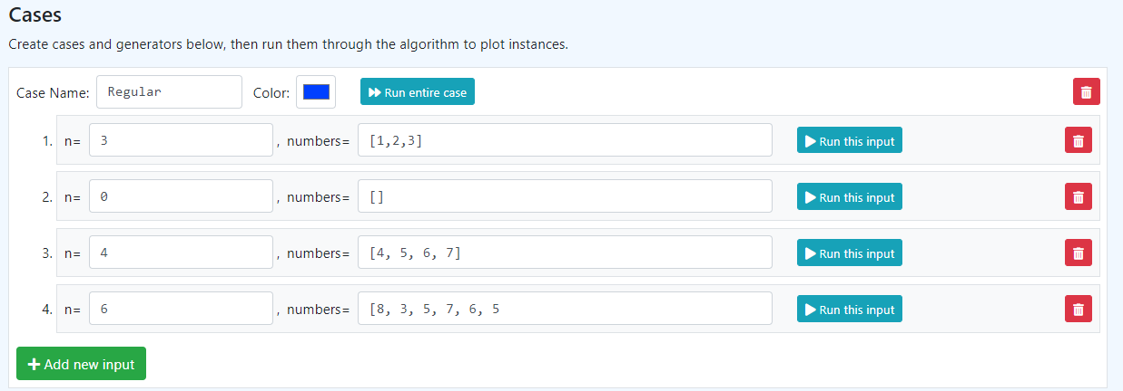
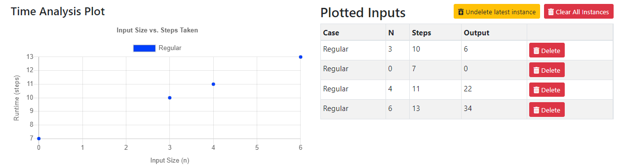
Runtime Case Builder
An educational tool that we’ll use to visualize the relationship between cases of input and the steps taken.
Notes:
Then you can introduce them to the tool we’re using today, the Runtime Case Builder.

Slide 14
A simple summate function
def summate(values: [int]) -> int:
total = 0
for value in values:
total = total + value
return total
print(summate([1, 2, 3]))
print(summate([]))
print(summate([4, 5, 6, 7]))
print(summate([8, 3, 5, 7, 6, 5]))
Notes:
This is basically the same as our code from before, but now we’re writing it as a function that takes a list of integers as a parameter instead.

Slide 15
Setting up the cases
The type of input varies depending on the problem. Usually a list and/or an integer.
Notes:
Each of the unit tests we saw before are now inputs for a case.

Slide 16
Running to make a plot

Slide 17
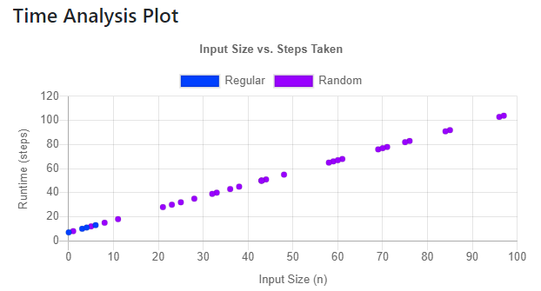
Linear Relationship
The exact equation of the line is tedious to calculate and error-prone. We really only care about the general shape.
To make the relationship clear, have MANY cases of input

Slide 18
Other shapes are possible
numbers = [...] #: list[int]
n = len(numbers)
# First + Last
ends = numbers[0] + numbers[-1]
# Summate list
sum = 0
for number in numbers:
sum += number
# Make a multiplication table
for left in numbers:
for right in numbers:
print(left,'*',right,'=',left*right)
Constant
Increasing n does not increase the steps taken
Linear
Increasing n requires one additional step
Quadratic
Increasing n requires n additional steps!

Slide 19

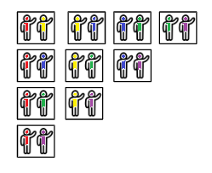


Metaphor: Constant - Linear - Quadratic
Imagine a photographer at a party taking photos...
Constant Time
Group Photo
Photographer takes one single group photo. Instant!
Linear Time
One Photo per Person
Photographer takes one photo of each person at the party. Not too bad, but more people means more time.
Quadratic Time
All Pairs
Photographer takes a photo of each possible pair of people. Every additional person requires a lot more photos!
Notes:
The exact formula for quadratic time here is n*(n-1), but let’s not bog them down with details. Hopefully they understand that each additional person means a lot more photos…
Note: The original raw editable people are below the “colored” versions if you want to fix my terrible paint job.

Slide 20

Lecture 9 - Time Analysis
Today we will use the Runtime Case Builder to analyze the runtime of programs.
Work in groups of three.
For each question in Part 3:
Read the algorithm
Write a one-sentence description
Predict its size-step relationship
Create and run cases with RCB
Click “Create Report” and copy/paste the result into the google doc.
We will review the answers here in class in about 15 minutes.
Notes:
You might want to review the next slide instead of launching in immediately, although I think it’s optional whether you show them those functions - if they’re getting it, they’re helpful tools. But if they’re struggling, better to stick with constants.

Slide 21
Some useful functions
len(a_list)
Get the number of elements in a list
randint(a, b)
Generate a random number between a and b.
Notes:
These might be helpful to leave on the board to help students when they are making cases.
Note that RuntimeCaseBuilder doesn’t require you to do any imports to get access to the randint function.

Slide 22
CISC108
Have a great day!
Don’t forget:
See ya!

